Slide 1




POINT–TO-POINT
WAN Technologies
Version 3.0
Cisco Regional Networking Academy

Slide 2
Objectives
Explain serial communication
Identify the demarcation point in a WAN
Describe the functions of the DTE and DCE
Identify the advantages of using PPP
Explain the functions of the Link Control Protocol (LCP) and the Network Control Protocol (NCP) components of PPP
Identify the three phases of a PPP session
Explain the difference between PAP and CHAP
List the steps in the PPP authentication process
Configure PPP encapsulation
Configure CHAP and PAP authentication

Slide 3
Table of Content
1 | Serial Point-to-point links
2 | PPP Authentication
3 | PPP configuration

Slide 4

SERIAL POINT-TO-POINT LINK

Slide 5
Introduction To Serial Communication
011111100110… ..11110
011111100110… ..11110
Transmission
system
Physical medium
Transmission
system
WAN technologies are based on serial transmission at the physical layer
The signaling methods include Nonreturn to Zero Level (NRZ-L), High Density Binary 3, (HDB3), and Alternative Mark Inversion (AMI).
Notes:
WAN technologies are based on serial transmission at the physical layer. This means that the bits of a frame are transmitted one at a time over the physical medium. The bits that make up the Layer 2 frame are signaled one at a time by physical layer processes onto the physical medium. The signaling methods include Nonreturn to Zero Level (NRZ-L), High Density Binary 3, (HDB3), and Alternative Mark Inversion (AMI). These are examples of physical layer encoding standards, similar to Manchester encoding for Ethernet. Among other things, these signaling methods differentiate between one serial communication method and another. Some of the many different serial communications standards are the following:
RS-232-E
V.35
High Speed Serial Interface (HSSI)

Slide 6
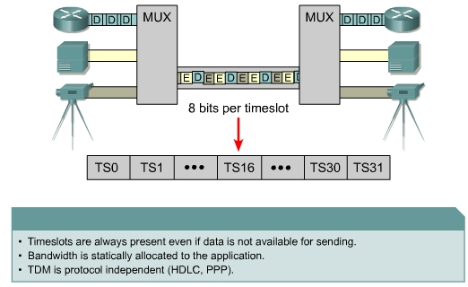
Time-division Multiplexing
Notes:
Time-Division Multiplexing (TDM) is the transmission of several sources of information using one common channel, or signal, and then the reconstruction of the original streams at the remote end. In the example shown in the first figure, there are three sources of information carried in turn down the output channel. First, a chunk of information is taken from each input channel. The size of this chunk may vary, but typically it is either a bit or a byte at a time. Depending on whether bits or bytes are used, this type of TDM is called bit-interleaving or byte-interleaving.
Each of the three input channels has its own capacity. For the output channel to be able to accommodate all the information from the three inputs, the capacity of the output channel must be no less than the sum of the inputs.
In TDM, the output timeslot is always present whether or not the TDM input has any information to transmit. TDM output can be compared to a train with 32 railroad cars. Each is owned by a different freight company and every day the train leaves with the 32 cars attached. If one of the companies has product to send, the car is loaded. If the company has nothing to send, the car remains empty, but it is still part of the train.
TDM is a physical layer concept, it has no regard for the nature of the information that is being multiplexed onto the output channel. TDM is independent of the Layer 2 protocol that has been used by the input channels.
One TDM example is Integrated Services Digital Network (ISDN). ISDN basic rate (BRI) has three channels consisting of two 64 kbps B-channels (B1 and B2), and a 16 kbps D-channel. The TDM has nine timeslots, which are repeated. This allows the telco to actively manage and troubleshoot the local loop as the demarcation point occurs after the network terminating unit (NTU).

Slide 7
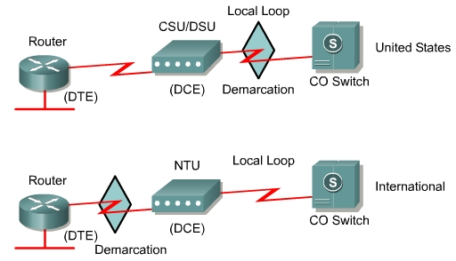
Demarcation Point
The demarcation point is the point in the network where the responsibility of the service provider
Notes:
The demarcation point, or "demarc" as it is commonly known, is the point in the network where the responsibility of the service provider or "telco" ends. In the United States, a telco provides the local loop into the customer premises and the customer provides the active equipment such as the channel service unit/data service unit (CSU/DSU) on which the local loop is terminated. This termination often occurs in a telecommunications closet and the customer is responsible for maintaining, replacing, or repairing the equipment. In other countries around the world, the network terminating unit (NTU) is provided and managed by the telco. This allows the telco to actively manage and troubleshoot the local loop with the demarcation point occurring after the NTU. The customer connects a customer premises equipment (CPE) device, such as a router or frame relay access device, into the NTU using a V.35 or RS-232 serial interface

Slide 8
DTE-DCE
The DCE, commonly a modem or CSU/DSU, is the device used to convert the user data from the DTE into a form acceptable to the WAN service provider transmission link.
The DTE-DCE interface for a particular standard defines the following specifications:
  Mechanical/physical – Number of pins and connector type
  Electrical – Defines voltage levels for 0 and 1
  Functional – Specifies the functions that are performed by assigning meanings to each of the signaling lines in
  Procedural – Specifies the sequence of events for transmitting data
Notes:
A serial connection has a data terminal equipment (DTE) device at one end of the connection and a data communications equipment (DCE) device at the other end. The connection between the two DCEs is the WAN service provider transmission network. The CPE, which is generally a router, is the DTE. Other DTE examples could be a terminal, computer, printer, or fax machine. The DCE, commonly a modem or CSU/DSU, is the device used to convert the user data from the DTE into a form acceptable to the WAN service provider transmission link. This signal is received at the remote DCE, which decodes the signal back into a sequence of bits. This sequence is then signaled to the remote DTE.
Many standards have been developed to allow DTEs to communicate with DCEs. The Electronics Industry Association (EIA) and the International Telecommunication Union Telecommunications Standardization Sector (ITU-T) have been most active in the development of these standards.
The DTE-DCE interface for a particular standard defines the following specifications:
Mechanical/physical – Number of pins and connector type
Electrical – Defines voltage levels for 0 and 1
Functional – Specifies the functions that are performed by assigning meanings to each of the signaling lines in the interface
Procedural – Specifies the sequence of events for transmitting data

Slide 9
DTE-DCE (cont.)
The synchronous serial port on a router is configured as DTE or DCE depending on the attached cable
The router end of the shielded serial transition cable may be a DB-60 connector
The serial end of the smart serial cable is a 26-pin connector significantly more compact than the DB-60 connector.
Notes:
If two DTEs must be connected together, like two computers or two routers in the lab, a special cable called a null-modem is necessary to eliminate the need for a DCE. For synchronous connections, where a clock signal is needed, either an external device or one of the DTEs must generate the clock signal.
The synchronous serial port on a router is configured as DTE or DCE depending on the attached cable, which is ordered as either DTE or DCE to match the router configuration. If the port is configured as DTE, which is the default setting, external clocking is required from the CSU/DSU or other DCE device.
The cable for the DTE to DCE connection is a shielded serial transition cable. The router end of the shielded serial transition cable may be a DB-60 connector, which connects to the DB-60 port on a serial WAN interface card. The other end of the serial transition cable is available with the connector appropriate for the standard that is to be used. The WAN provider or the CSU/DSU usually dictates this cable type. Cisco devices support the EIA/TIA-232, EIA/TIA-449, V.35, X.21, and EIA/TIA-530 serial standards.
To support higher densities in a smaller form factor, Cisco has introduced a smart serial cable. The serial end of the smart serial cable is a 26-pin connector significantly more compact than the DB-60 connector.

Slide 10
HDLC Encapsulation
HDLC uses synchronous serial transmission providing error-free communication between two points.
HDLC defines a Layer 2 framing structure that allows for flow control and error control using acknowledgments and a windowing scheme.
Each frame has the same format, whether it is a data frame or a control frame
Standard HDLC does not inherently support multiple protocols on a single link
The Cisco HDLC frame allows multiple network layer protocols to share the same serial link
Notes:
Initially, serial communications were based on character-oriented protocols. Bit-oriented protocols were more efficient but they were also proprietary. In 1979, the ISO agreed on HDLC as a standard bit-oriented data link layer protocol that encapsulates data on synchronous serial data links. This standardization led to other committees adopting it and extending the protocol. Since 1981, ITU-T has developed a series of HDLC derivative protocols. The following examples of derivative protocols are called link access protocols:
Link Access Procedure, Balanced (LAPB) for X.25
Link Access Procedure on the D channel (LAPD) for ISDN
Link Access Procedure for Modems (LAPM) and PPP for modems
Link Access Procedure for Frame Relay (LAPF) for Frame Relay
HDLC uses synchronous serial transmission providing error-free communication between two points. HDLC defines a Layer 2 framing structure that allows for flow control and error control using acknowledgments and a windowing scheme. Each frame has the same format, whether it is a data frame or a control frame.
Standard HDLC does not inherently support multiple protocols on a single link, as it does not have a way to indicate which protocol is being carried. Cisco offers a proprietary version of HDLC. The Cisco HDLC frame uses a proprietary ‘type’ field that acts as a protocol field. This field enables multiple network layer protocols to share the same serial link. HDLC is the default Layer 2 protocol for Cisco router serial interfaces.

Slide 11
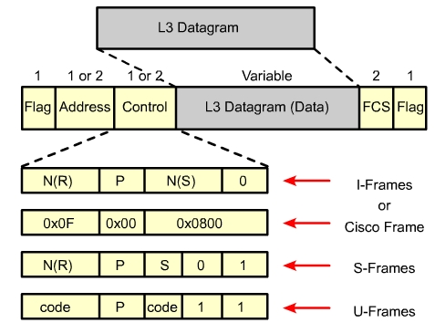
HDLC Encapsulation (cont.)
Notes:
HDLC defines the following three types of frame, each with a different control field format:
Information frames (I-frames) – Carry the data to be transmitted for the station. Additional flow and error control - data may be piggybacked on an information frame.
Supervisory frames (S-frames) – Provide request/response mechanisms when piggybacking is not used.
Unnumbered frames (U-frames) – Provide supplemental link control functions, such as connection setup. The code field identifies the U-frame type.
The first one or two bits of the control field serve to identify the frame type. In the control field of an Information (I) frame, the send-sequence number refers to the number of the frame to be sent next. The receive-sequence number provides the number of the frame to be received next. Both sender and receiver maintain send and receive sequence numbers.

Slide 12
Configuring HDLC Encapsulation
Enter the interface configuration mode of the serial interface.
Then enter the encapsulation hdlc command to specify the encapsulation protocol on the interface.
When communicating with a non-Cisco device, synchronous PPP is a more viable option.
Notes:
on synchronous serial lines is Cisco HDLC. If the serial interface is configured with another encapsulation protocol, and the encapsulation must be changed back to HDLC, enter the interface configuration mode of the serial interface. Then enter the encapsulation hdlc command to specify the encapsulation protocol on the interface.
Cisco HDLC is a point-to-point protocol that can be used on leased lines between two Cisco devices. When communicating with a non-Cisco device, synchronous PPP is a more viable option.

Slide 13
Troubleshooting A Serial Interface
show interfaces serial
  Serial x is down, line protocol is down
  Serial x is up, line protocol is down
  Serial x is up, line protocol is up (looped)
  Serial x is up, line protocol is down (disabled)
  Serial x is administratively down, line protocol is down

Slide 14
Troubleshooting A Serial Interface
show controllers
debug serial interface
debug frame-relay lmi
debug frame-relay events
debug ppp negotiation
Notes:
debug serial interface – Verifies whether HDLC keepalive packets are incrementing. If they are not, a possible timing problem exists on the interface card or in the network.
debug arp – Indicates whether the router is sending information about or learning about routers (with ARP packets) on the other side of the WAN cloud. Use this command when some nodes on a TCP/IP network are responding, but others are not.
debug frame-relay lmi – Obtains Local Management Interface (LMI) information which is useful for determining whether a Frame Relay switch and a router are sending and receiving LMI packets.
debug frame-relay events – Determines whether exchanges are occurring between a router and a Frame Relay switch.
debug ppp negotiation – Shows Point-to-Point Protocol (PPP) packets transmitted during PPP startup where PPP options are negotiated.
debug ppp packet – Shows PPP packets being sent and received. This command displays low-level packet dumps.
debug ppp – Shows PPP errors, such as illegal or malformed frames, associated with PPP connection negotiation and operation.
debug ppp authentication – Shows PPP Challenge Handshake Authentication Protocol (CHAP) and Password Authentication Protocol (PAP) packet exchanges.
Caution: Debugging output is assigned high priority in the CPU process and can render the system unusable. For this reason, debug commands should only be used to troubleshoot specific problems or during troubleshooting sessions with Cisco technical support staff. It is good practice to use debug commands during periods of low network traffic and when the fewest users are online. Debugging during these periods decreases the likelihood that increased debug command processing overhead will affect system use.

Slide 15
PPP AUTHENTICATION

Slide 16
PPP Layered Architecture
PPP uses a layered architecture. A layered architecture is a logical model, design, or blueprint that aids in communication between interconnecting layers.
PPP provides a method for encapsulating multi-protocol datagrams over a point-to-point link, and uses the data link layer for testing the connection.
PPP is made up of two sub-protocols:
  Link Control Protocol – Used for establishing the point-to-point link.
  Network Control Protocol – Used for configuring the various network layer protocols.
Notes:
PPP uses a layered architecture. A layered architecture is a logical model, design, or blueprint that aids in communication between interconnecting layers. The Open System Interconnection (OSI) model is the layered architecture used in networking. PPP provides a method for encapsulating multi-protocol datagrams over a point-to-point link, and uses the data link layer for testing the connection. Therefore PPP is made up of two sub-protocols:
Link Control Protocol – Used for establishing the point-to-point link.
Network Control Protocol – Used for configuring the various network layer protocols.

Slide 17
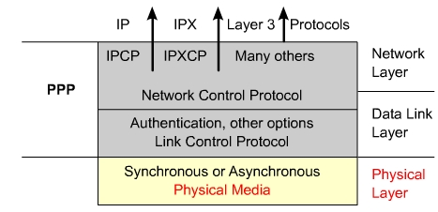
PPP Layered Architecture (Cont.)
- Asynchronous serial
- Synchronous serial
- High-Speed Serial Interface (HSSI)
- Integrated Services Digital Network (ISDN)

Slide 18
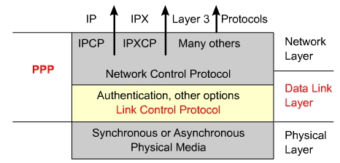
PPP Layered Architecture (Cont.)
Authentication
Compression
Error detection
Multilink
PPP Callback
Notes:
PPP uses Link Control Protocol (LCP) to negotiate and setup control options on the WAN data link. PPP uses the Network Control Protocol (NCP) component to encapsulate and negotiate options for multiple network layer protocols. The LCP sits on top of the physical layer and is used to establish, configure, and test the data-link connection.
PPP also uses LCP to automatically agree upon encapsulation format options such as:
Authentication – Authentication options require that the calling side of the link enter information to help ensure the caller has the network administrator's permission to make the call. Peer routers exchange authentication messages. Two authentication choices are Password Authentication Protocol (PAP) and Challenge Handshake Authentication Protocol (CHAP).
Compression – Compression options increase the effective throughput on PPP connections by reducing the amount of data in the frame that must travel across the link. The protocol decompresses the frame at its destination. Two compression protocols available in Cisco routers are Stacker and Predictor.
Error detection – Error detection mechanisms with PPP enable a process to identify fault conditions. The Quality and Magic Number options help ensure a reliable, loop-free data link.
Multilink – Cisco IOS Release 11.1 and later supports multilink PPP. This alternative provides load balancing over the router interfaces that PPP uses.
PPP Callback – To further enhance security, Cisco IOS Release 11.1 offers callback over PPP. With this LCP option, a Cisco router can act as a callback client or as a callback server. The client makes the initial call, requests that it be called back, and terminates its initial call. The callback router answers the initial call and makes the return call to the client based on its configuration statements.
LCP will also do the following:
Handle varying limits on packet size
Detect common misconfiguration errors
Terminate the link
Determine when a link is functioning properly or when it is failing

Slide 19
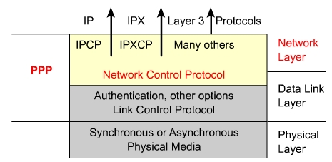
PPP Layered Architecture (Cont.)
For every network layer protocol used, a separate
Network Control Protocol (NCP) is provided.
NCP includes functional fields containing standardized
codes to indicate the network layer protocol type
Notes:
PPP permits multiple network layer protocols to operate on the same communications link. For every network layer protocol used, a separate Network Control Protocol (NCP) is provided. For example, Internet Protocol (IP) uses the IP Control Protocol (IPCP), and Internetwork Packet Exchange (IPX) uses the Novell IPX Control Protocol (IPXCP). NCPs include functional fields containing standardized codes to indicate the network layer protocol type that PPP encapsulates.

Slide 20
PPP Layered Architecture (Cont.)
Flag – Indicates the beginning or end of a frame
and consists of the binary sequence 01111110.
Address – Consists of the standard broadcast
address, which is the binary sequence 11111111.
Control – 1 byte that consists of the binary
sequence 00000011,
Protocol – 2 bytes that identify the protocol
encapsulated in the data field of the frame.
Data – 0 or more bytes
FCS – Normally 16 bits or 2 bytes that refers to the
extra characters added to a frame for error
control purposes.
Notes:
Flag – Indicates the beginning or end of a frame and consists of the binary sequence 01111110.
Address – Consists of the standard broadcast address, which is the binary sequence 11111111. PPP does not assign individual station addresses.
Control – 1 byte that consists of the binary sequence 00000011, which calls for transmission of user data in an unsequenced frame. A connection-less link service similar to that of Logical Link Control (LLC) Type 1 is provided.
Protocol – 2 bytes that identify the protocol encapsulated in the data field of the frame.
Data – 0 or more bytes that contain the datagram for the protocol specified in the protocol field. The end of the data field is found by locating the closing flag sequence and allowing 2 bytes for the frame check sequence (FCS) field. The default maximum length of the data field is 1,500 bytes.
FCS – Normally 16 bits or 2 bytes that refers to the extra characters added to a frame for error control purposes.

Slide 21
Establishing A PPP Session
Link-establishment frames are used to establish and configure a link.
Link-termination frames are used to terminate a link.
Link-maintenance frames are used to manage and debug a link.
Notes:
PPP session establishment progresses through three phases. These phases are link establishment, authentication, and the network layer protocol phase. LCP frames are used to accomplish the work of each of the LCP phases. The following three classes of LCP frames are used in a PPP session:
Link-establishment frames are used to establish and configure a link.
Link-termination frames are used to terminate a link.
Link-maintenance frames are used to manage and debug a link.

Slide 22
Establishing A PPP Session: Link-establishment phase
In this phase each PPP device sends LCP frames to configure and test the data link.
LCP frames contain a configuration option field that allows devices to negotiate the use of options such as
  maximum transmission unit (MTU),
  compression of certain PPP fields,
  link-authentication protocol.
If a configuration option is not included in an LCP packet, the default value for that configuration option is assumed
This phase is complete when a configuration acknowledgment frame has been sent and received.

Slide 23
Establishing A PPP Session: Authentication phase
Authentication phase (optional) – After the link has been established and the authentication protocol decided on, the peer may be authenticated.
Authentication, if used, takes place before the network layer protocol phase is entered.
LCP also allows for an optional link-quality determination test.
The link is tested to determine whether the link quality is good enough to bring up network layer protocols
Notes:
Authentication phase (optional) – After the link has been established and the authentication protocol decided on, the peer may be authenticated. Authentication, if used, takes place before the network layer protocol phase is entered. As part of this phase, LCP also allows for an optional link-quality determination test. The link is tested to determine whether the link quality is good enough to bring up network layer protocols

Slide 24
Establishing A PPP Session:Network layer phase
In this phase the PPP devices send NCP packets to choose and configure one or more network layer protocols, such as IP.
Once each of the chosen network layer protocols has been configured, packets from each network layer protocol can be sent over the link
The show interfaces command reveals the LCP and NCP states under PPP configuration
Notes:
Network layer protocol phase – In this phase the PPP devices send NCP packets to choose and configure one or more network layer protocols, such as IP. Once each of the chosen network layer protocols has been configured, packets from each network layer protocol can be sent over the link. If LCP closes the link, it informs the network layer protocols so that they can take appropriate action. The show interfaces command reveals the LCP and NCP states under PPP configuration

Slide 25
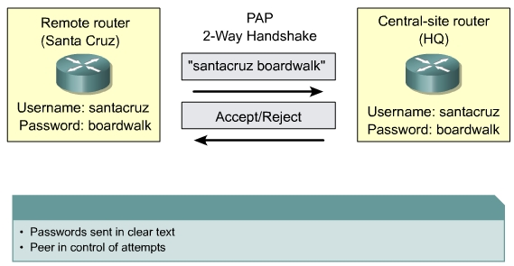
PPP Authentication Protocols:PAP
Notes:
PAP provides a simple method for a remote node to establish its identity, using a two-way handshake. After the PPP link establishment phase is complete, a username/password pair is repeatedly sent by the remote node across the link until authentication is acknowledged or the connection is terminated.
PAP is not a strong authentication protocol. Passwords are sent across the link in clear text and there is no protection from playback or repeated trial-and-error attacks. The remote node is in control of the frequency and timing of the login attempts

Slide 26
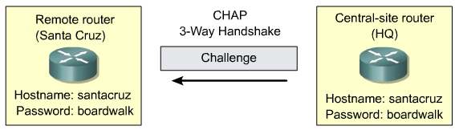
PPP Authentication Protocols:CHAP
CHAP is used at the startup of a link and periodically
verifies the identity of the remote node using a
three-way handshake.
Notes:
CHAP is used at the startup of a link and periodically verifies the identity of the remote node using a three-way handshake. CHAP is performed upon initial link establishment and is repeated during the time the link is established. After the PPP link establishment phase is complete, the local router sends a "challenge" message to the remote node. The remote node responds with a value calculated using a one-way hash function, which is typically Message Digest 5 (MD5). This response is based on the password and challenge message. The local router checks the response against its own calculation of the expected hash value. If the values match, the authentication is acknowledged, otherwise the connection is immediately terminated.
CHAP provides protection against playback attack through the use of a variable challenge value that is unique and unpredictable. Since the challenge is unique and random, the resulting hash value will also be unique and random. The use of repeated challenges is intended to limit the time of exposure to any single attack. The local router or a third-party authentication server is in control of the frequency and timing of the challenges.

Slide 27
PPP Authentication Protocols:CHAP Operation
Sydney
Hongkong
Challenge
Sydney
Random
ID
01
Username Password
Sysney cisco
Melbourne sanhinoon
Username Password
Hongkong cisco
Melbourne sanhinoon
MD5
MD5
Hash #
Response
Hash #
Hongkong
Hash#
ID
02
Is Equal?
Sydney
Ack/Nack
ID
03

Slide 28
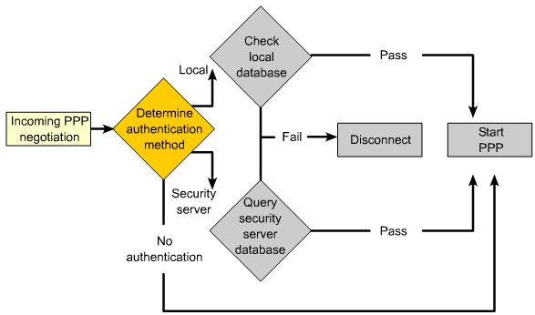
PPP Encapsulation And Authentication Process
Notes:
When the encapsulation ppp command is used either PAP or CHAP authentication can be optionally added. If no authentication is specified the PPP session starts immediately. If authentication is required the process proceeds through the following steps:
The method of authentication is determined.
The local database or security server, which has a username and password database, is checked to see if the given username and password pair matches.
The process checks the authentication response sent back from the local database. If it is a positive response, the PPP session is started. If negative, the session is terminated.
The Figure and corresponding Figure details the CHAP authentication process.

Slide 29
CONFIGURING PPP

Slide 30
Configuring PPP
Enable PPP
  Router(config)#interface serial 0/0
  Router(config-if)#encapsulation ppp
To configure compression over PPP, enter the following commands:
  Router(config-if)#compress [predictor | stac]
Enter the following to monitor the data dropped on the link, and avoid frame looping:
  Router(config-if)#ppp quality percentage
The following commands perform load balancing across multiple links:
  Router(config-if)#ppp multilink
Notes:
The following example enables PPP encapsulation on serial interface 0/0:
Router#configure terminal
Router(config)#interface serial 0/0
Router(config-if)#encapsulation ppp
Point-to-point software compression can be configured on serial interfaces that use PPP encapsulation. Compression is performed in software and might significantly affect system performance. Compression is not recommended if most of the traffic consists of compressed files.
To configure compression over PPP, enter the following commands:
Router(config)#interface serial 0/0
Router(config-if)#encapsulation ppp
Router(config-if)#compress [predictor | stac]
Enter the following to monitor the data dropped on the link, and avoid frame looping:
Router(config)#interface serial 0/0
Router(config-if)#encapsulation ppp
Router(config-if)#ppp quality percentage
The following commands perform load balancing across multiple links:
Router(config)#interface serial 0/0
Router(config-if)#encapsulation ppp
Router(config-if)#ppp multilink

Slide 31
Configuring PPP authentication
Step 1: Define username and password to expect from remote router
  Router(config)#username remote password secret
  Secret must be the same at both ends
Step 2: Enable PPP
  Router(config-if) encapsulation ppp
Step 3: Configure authentication
  Router(config-if) Ppp authentication { pap|chap|pap- chap|chap-pap}
Step 4: if IOS 11.1 or later, PAP must be enable on interface
  Router(config-if)ppp pap sent-username user password pass
Notes:
The procedure outlined in the table describes how to configure PPP encapsulation and PAP/CHAP authentication protocols.
Correct configuration is essential, since PAP and CHAP will use these parameters to authenticate.
Figure is an example of a two-way PAP authentication configuration. Both routers authenticate and are authenticated, so the PAP authentication commands mirror each other. The PAP username and password that each router sends must match those specified with the username name password password command of the other router.
PAP provides a simple method for a remote node to establish its identity using a two-way handshake. This is done only upon initial link establishment. The hostname on one router must match the username the other router has configured. The passwords must also match.
CHAP is used to periodically verify the identity of the remote node using a 3-way handshake. The hostname on one router must match the username the other router has configured. The passwords must also match. This is done upon initial link establishment and can be repeated any time after the link has been established.

Slide 32
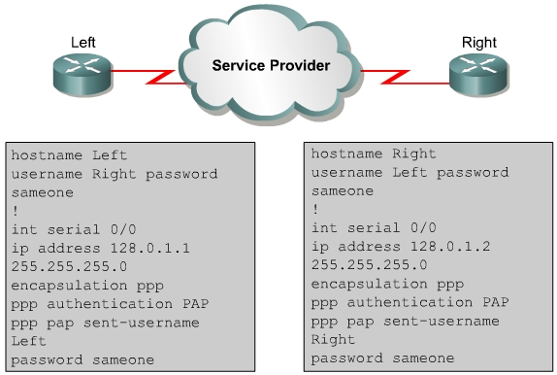
Configuring PPP authentication

Slide 33
Verifying The Serial PPP Encapsulation Configuration
Houston#sh int serial 1/0:1
Serial1/0:1 is up, line protocol is up
Hardware is DSX1
Internet address is 10.10.10.3/24
MTU 1500 bytes, BW 64 Kbit, DLY 20000 usec,
reliability 255/255, txload 1/255, rxload 1/255
Encapsulation PPP, loopback not set
Keepalive set (10 sec)
LCP Open
Open: IPCP, CDPCP
Last input 00:00:09, output 00:53:17, output hang never
Last clearing of "show interface" counters 01:09:05
Input queue: 0/75/0/0 (size/max/drops/flushes); Total output drops: 164
Queueing strategy: weighted fair
Output queue: 0/1000/64/0 (size/max total/threshold/drops)
Conversations 0/1/256 (active/max active/max total)
Reserved Conversations 0/0 (allocated/max allocated)
--More--

Slide 34
Troubleshooting The Serial Encapsulation Configuration
right#debug ppp negotiation
00:02:28: %LINK-3-UPDOWN: Interface Serial0/0, changed state to up
00:02:28: Se0/0 PPP: Using default call direction
<omit>
right(config-i8: Se0/0 PPP: Phase is AUTHENTICATING, by both [0 sess, 0 load]
00:02:28: Se0/0 CHAP: O CHALLENGE id 14 len 26 from "right"
00:02:28: Se0/0 CHAP: I CHALLENGE id 17 len 25 from "left"
00:02:28: Se0/0 CHAP: O RESPONSE id 17 len 26 from "right"
00:02:28: Se0/0 CHAP: I RESPONSE id 14 len 25 from "left"
00:02:28: Se0/0 CHAP: O SUCCESS id 14 len 4
00:02:28: Se0/0 CHAP: I SUCCESS id 17 len 4
left
right
Notes:
The debug ppp authentication command displays the authentication exchange sequence. Figure illustrates the Left router output during CHAP authentication with the router on the right when debug ppp authentication is enabled. With two-way authentication configured, each router authenticates the other. Messages appear for both the authenticating process and the process of being authenticated. Use the debug ppp authentication command to display the exchange sequence as it occurs.
Figure highlights router output for a two-way PAP authentication.
The debug ppp command is used to display information about the operation of PPP. The no form of this command disables debugging output.
Router#debug ppp {authentication | packet | negotiation | error | chap}
Router#no debug ppp {authentication | packet | negotiation | error | chap}

Slide 35
Summary
Explain serial communication
Identify the demarcation point in a WAN
Describe the functions of the DTE and DCE
Identify the advantages of using PPP
Explain the functions of the Link Control Protocol (LCP) and the Network Control Protocol (NCP) components of PPP
Identify the three phases of a PPP session
Explain the difference between PAP and CHAP
List the steps in the PPP authentication process
Configure PPP encapsulation
Configure CHAP and PAP authentication

Slide 36
Enjoy the Course
Notes:
_________________________________________________________________________
_________________________________________________________________________
_________________________________________________________________________
_________________________________________________________________________
_________________________________________________________________________
_________________________________________________________________________
_________________________________________________________________________
_________________________________________________________________________
_________________________________________________________________________
_________________________________________________________________________
_________________________________________________________________________
_________________________________________________________________________
_________________________________________________________________________
_________________________________________________________________________
_________________________________________________________________________
_________________________________________________________________________
_________________________________________________________________________
_________________________________________________________________________
_________________________________________________________________________

